Slide 1
Introduction to Learning Algorithms K-Means
Introduction to Data Analysis 094202

Slide 2
Supervised vs. Unsupervised Learning Algorithms
Supervised Learning
Data is labeled.
The algorithm’s goal is to predict how to label a new data point based on the input data.
Used in the context of classification or regression.
Unsupervised Learning
Data is unlabeled.
The algorithm’s goal is to model the structure of the data.
Used is the context of clustering.

Slide 3
K-Means
K-Means is an unsupervised learning algorithm.
Used for clustering
How it works?
Pick a value for K (the number of clusters to create)
Initialize K centroids.
Assign each point to the nearest centroid.
Move centroid to the center of the cluster.
Repeat until centroids converges.

Slide 4
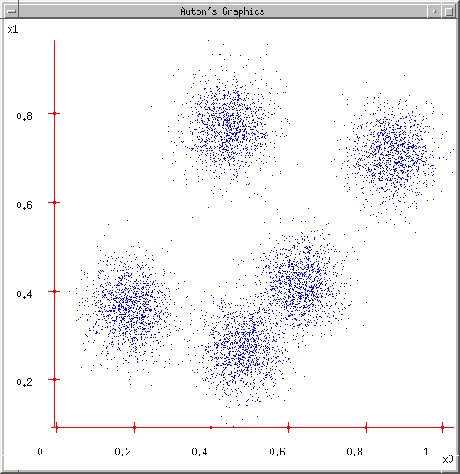
K-Means
Choose randomly k clusters.

Slide 5
K-Means
Choose randomly k clusters. (e.g. k=5)
Randomly guess k cluster Center locations

Slide 6
K-Means
Choose randomly k clusters. (e.g. k=5)
Randomly guess k cluster Center locations
Each datapoint finds out which Center it’s closest to. (Thus each Center “owns” a set of datapoints)

Slide 7
K-Means
Choose randomly k clusters. (e.g. k=5)
Randomly guess k cluster Center locations
Each datapoint finds out which Center it’s closest to.
Each Center finds the centroid of the points it owns…

Slide 8
K-Means
Choose randomly k clusters. (e.g. k=5)
Randomly guess k cluster Center locations
Each datapoint finds out which Center it’s closest to.
Each Center finds the centroid of the points it owns…
…and jumps there
…Repeat until terminated!

Slide 9
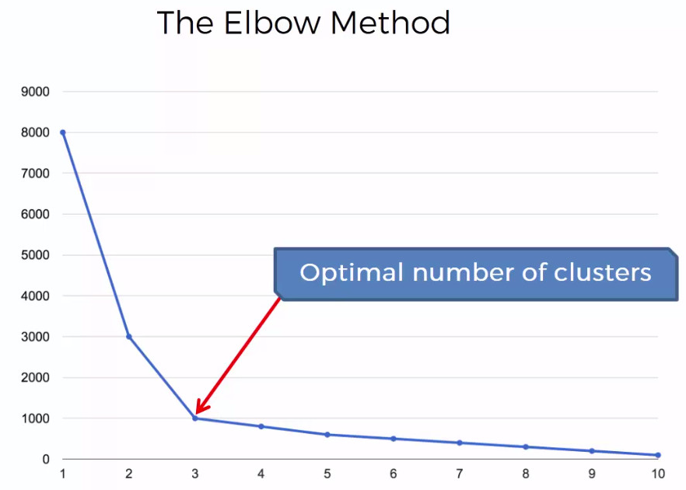
K-Means: Choose Optimal K – The Elbow Method
Run iterations with various number of clusters.
On each iteration calculate the sum of squared distances between data points and their assigned centroids.
Pick the K at the spot where the SSE starts to flatten out forming ‘an elbow’.

